Slide 1
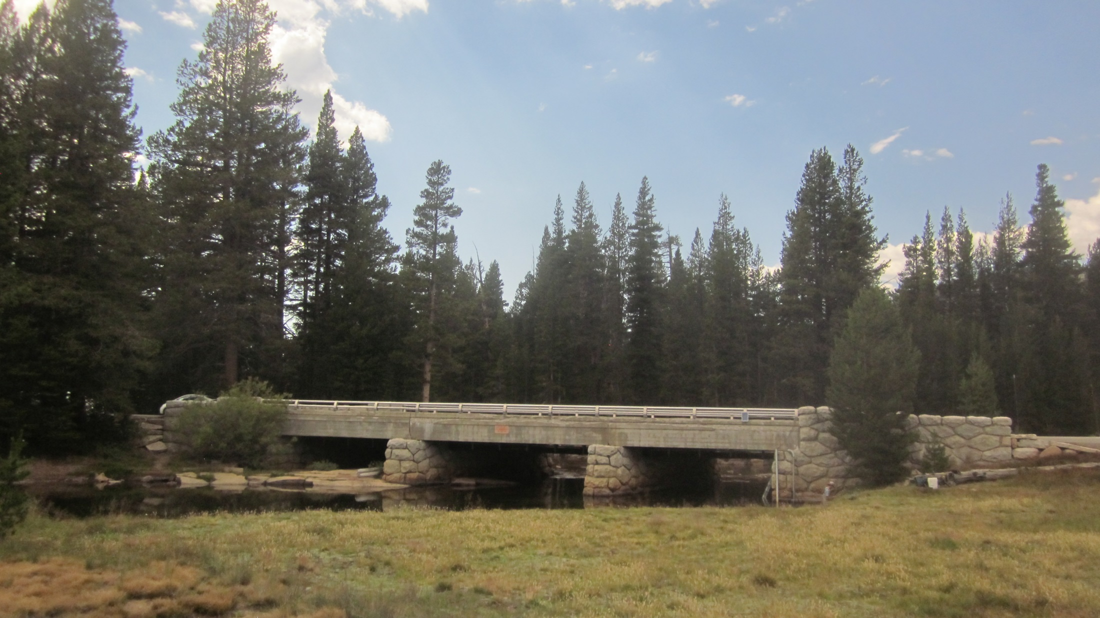
Tuolumne River @ Tioga Rd. (Hwy. 120) Bridge:
updated 7/31/2015
Photo: 7/30/2015
Solinst stilling tube install: 2002
Staff plate install: 2006
CR1000 & CS450 P.T install: 10/10/2012
Photo: 7/24/2012

Slide 2
Real-time data access:
http://cdec.water.ca.gov/queryQuick.html
Site Code: TUM (includes snow-shed variables)
Archived data access:
https://irma.nps.gov/aqwebportal/
Sierra Nevada Network>Rivers Monitoring>Tuolumne River At Tioga Road
Currently available time series:
Discharge (daily mean flow): 10/1/2002 - 8/27/2014
Discharge (30min/15min): 30min(7/3/2008 – 10/10/2012); 15min (10/10/2012 – last dwnld)
Discharge – field visits : 8/28/2002 – 7/20/2015
Stage – field visits: 8/28/2002 – 7/29/2015

Slide 3
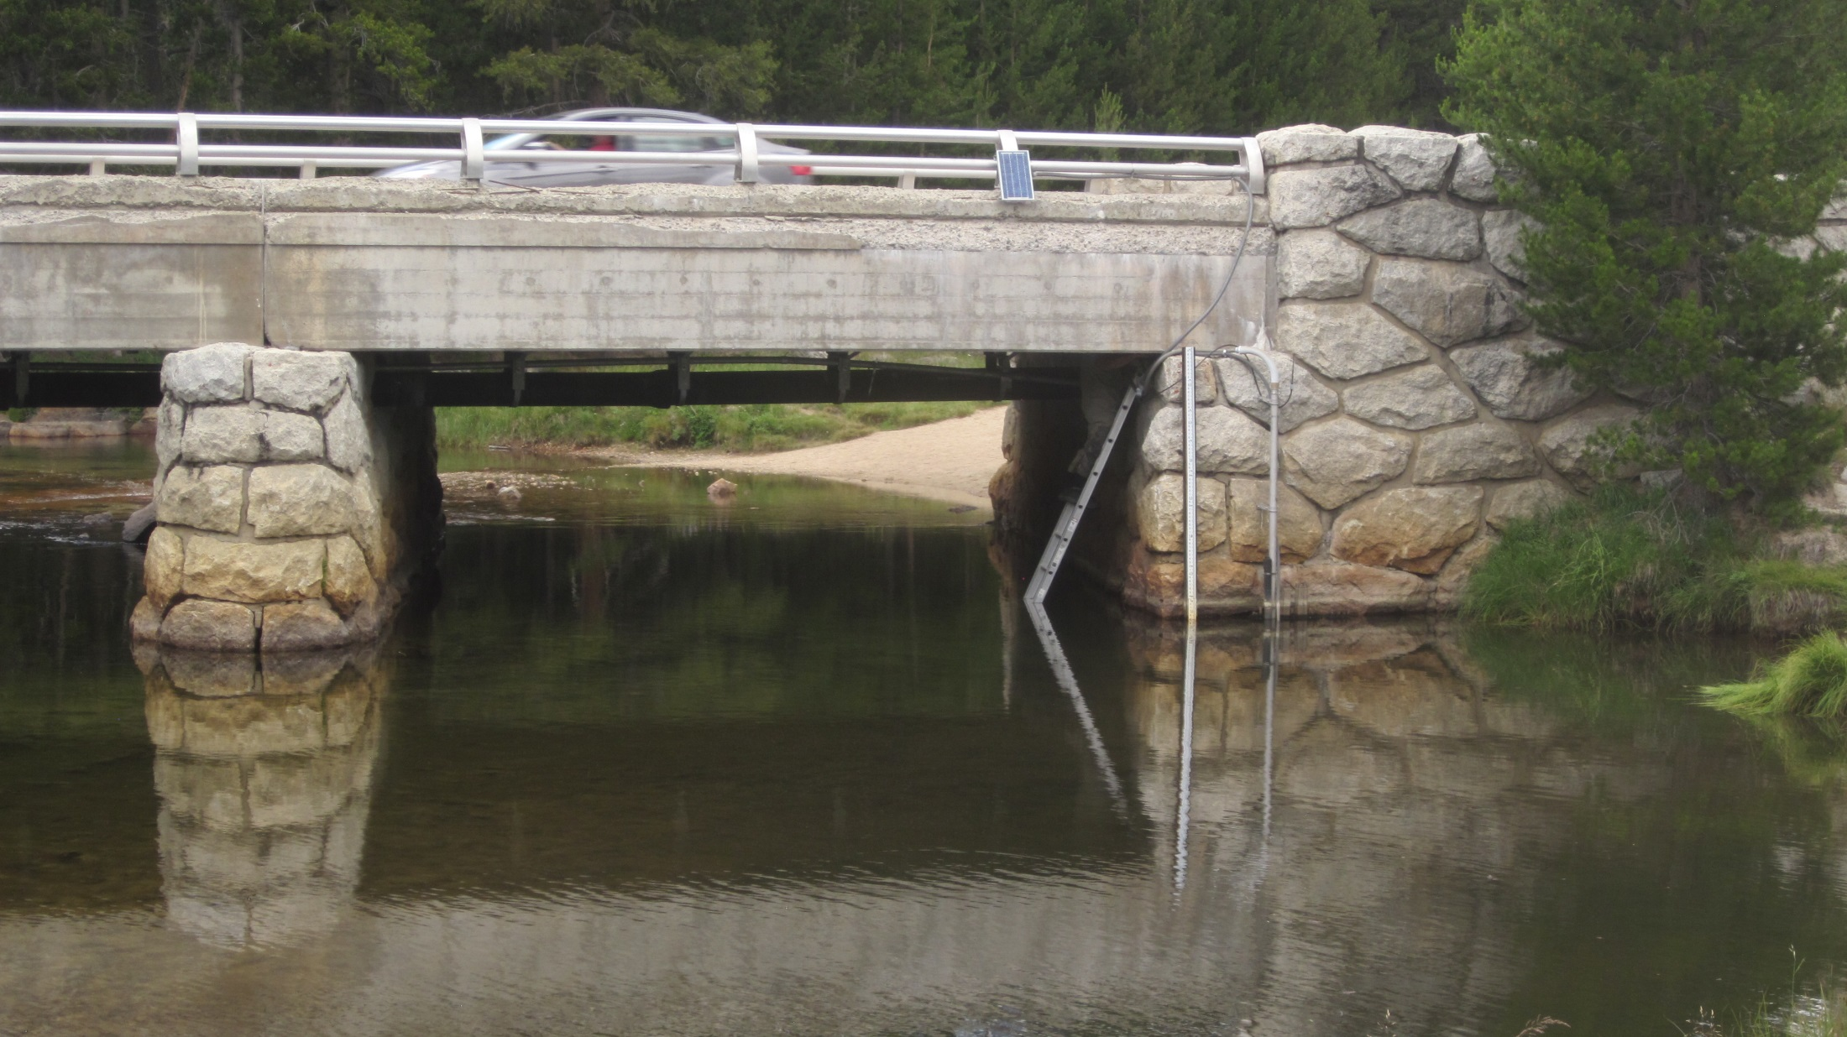
Datalogger enclosure w/CR1000, install 10/10/2012 (under bridge)
Corded Solinst (Silver model), black stilling tube, install 2002
CS450 P.T (tall metal stilling tube), install 10/10/2012
FLOW
Photo: 7/17/2015

Slide 4
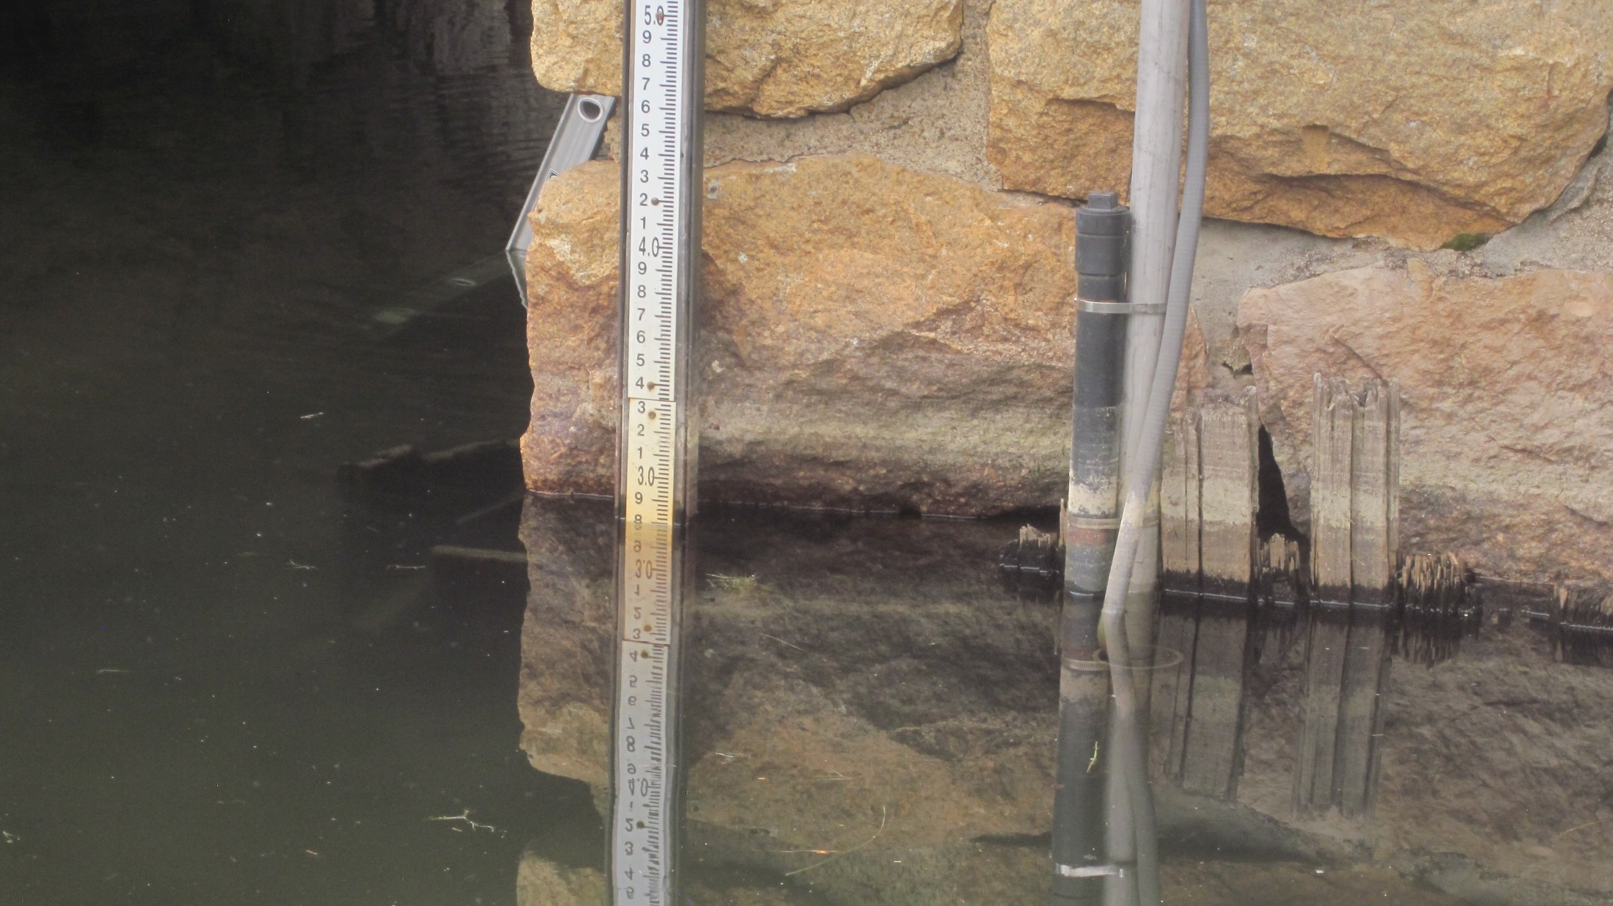
Staff plate, Install 2006 (USGS/SFPUC)
Corded Solinst (Silver model) black stilling tube install 2002
CS450 P.T (tall metal stilling tube) install 10/10/2012
DTS-12 Turbidity
Sensor (inside black
solar shield - 4 in. pipe)
Photos: 7/30/2015

Slide 5
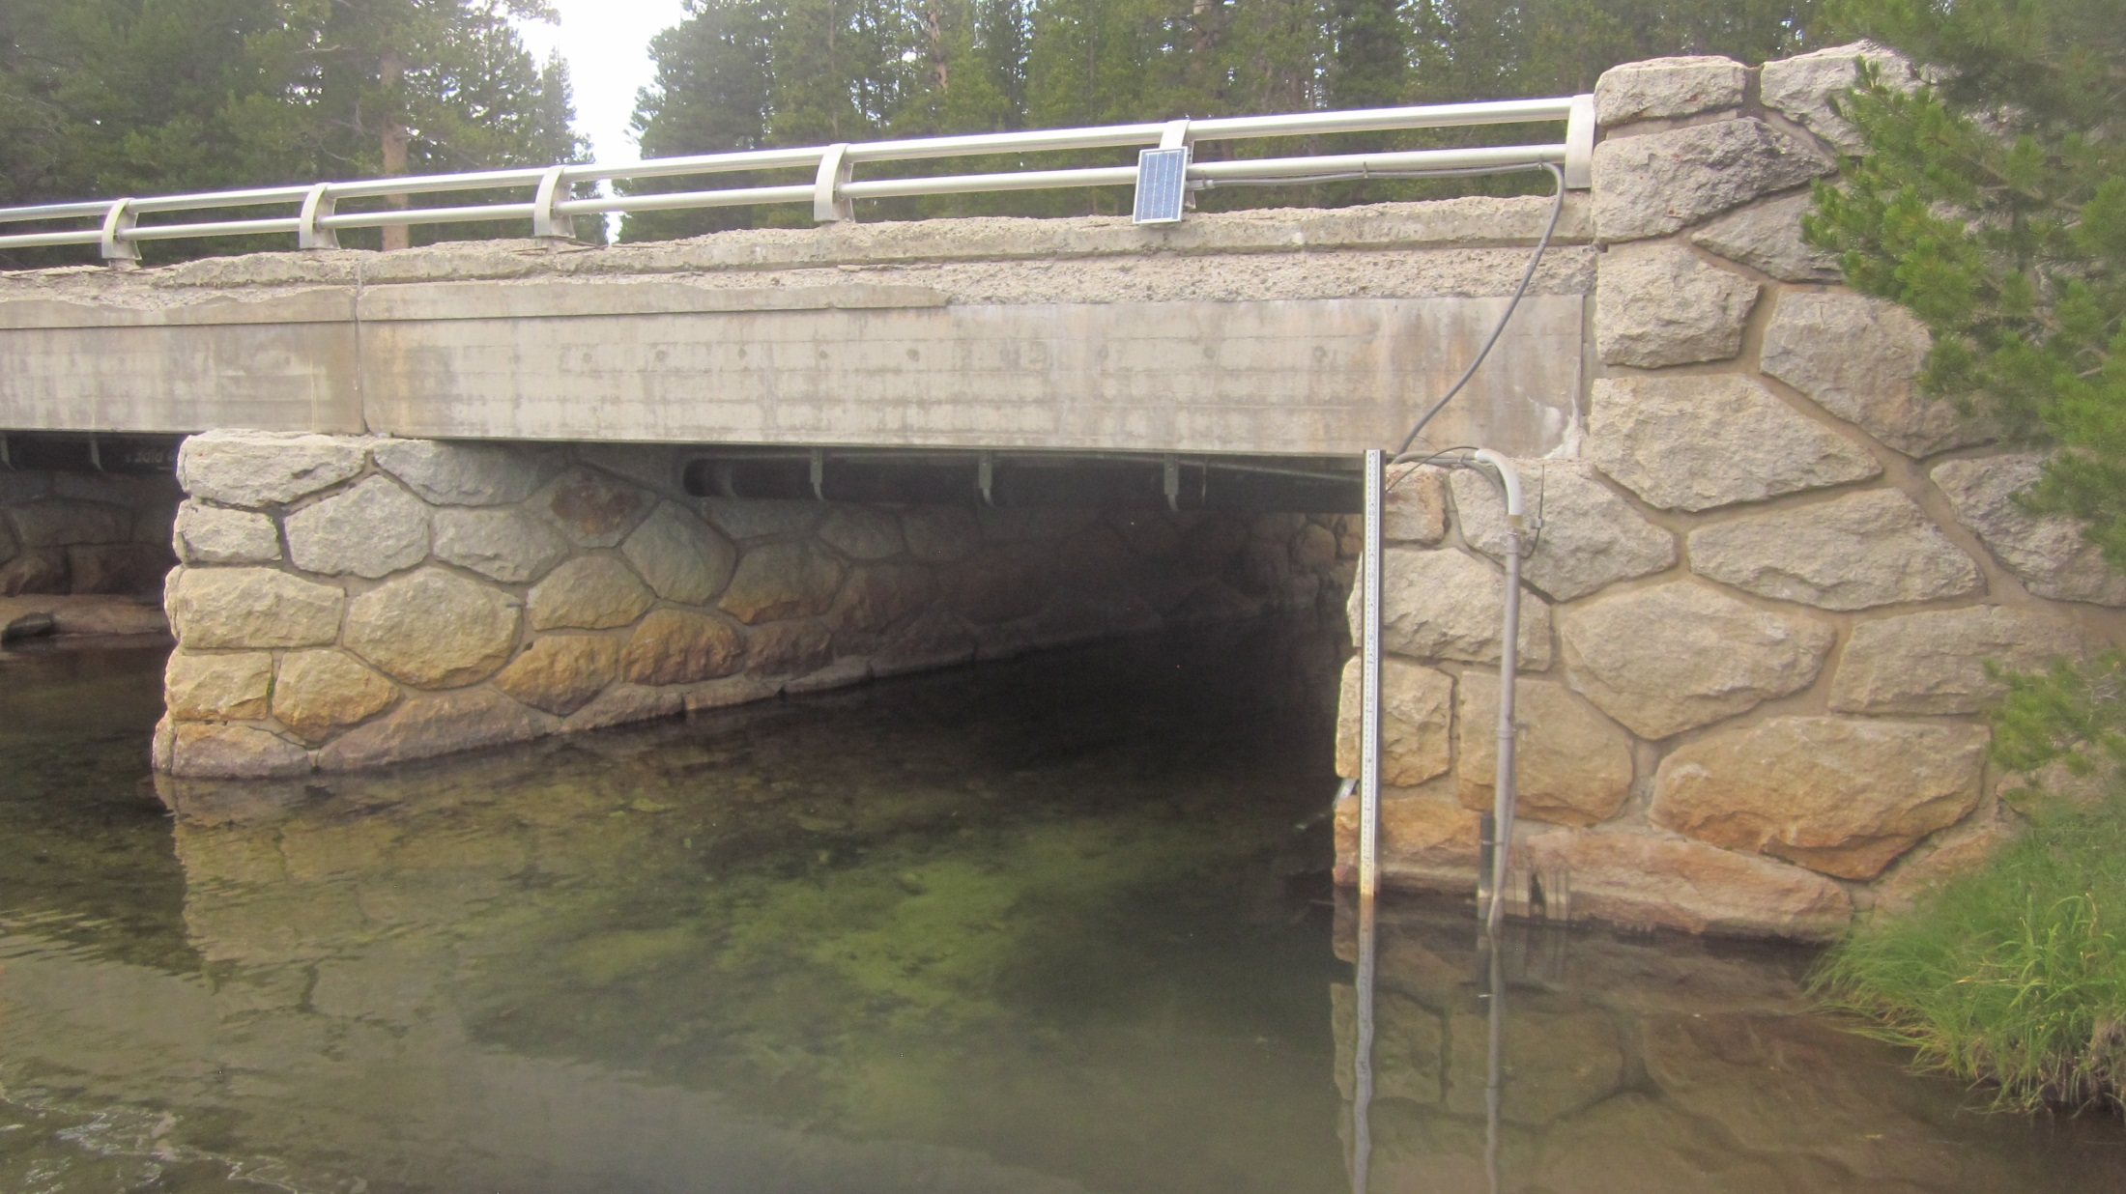
1 ft. RF antennae
(to Tuolumne Meadows
Snow Sensor)
10W BP-Solar
Solar Panel
Datalogger program stored under:
YOSE “U” drive>…>Aquarius Data >
Tuolumne River@Tioga Rd.>
Datalogger Programs
Datalogger output to Snow Shed
Sub HandarArray
sendCR1000data (1) = BattV
sendCR1000data (2) = Lvl_ft_2_corr
sendCR1000data (3) = Temp_C_2
sendCR1000data (4) = MedianTurbidity
sendCR1000data (5) = VarianceTurbidity
Offset to match Gage Height (Staff Plate)
PT#1: -0.832 on 7/28/2015 (Backup Stage)
PT#2: -0.827 on 7/28/2015 (Primary Stage)

Slide 6
Bridge-top download: Need to install Serial->
USB converter driver by direct connection to
converter with “USB/Serial Bus”(2 ft. USB cable).
7/31/2015-Dell Rugged Latitude 5404 dwnld works,
Dell Field Tablet (USGS) dwnld does not work
90° conduit connector – USB download
cable (access via screw panel).
Need Phillips screw driver.
Installed 7/30/2015

Slide 7
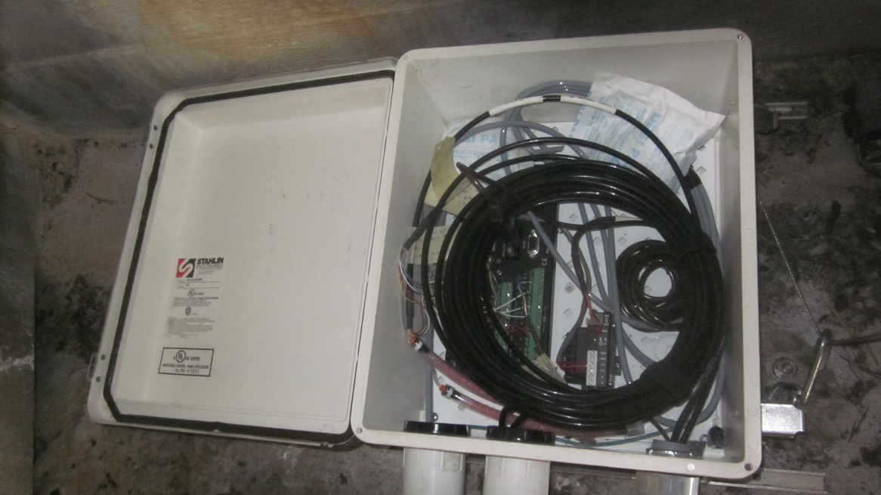
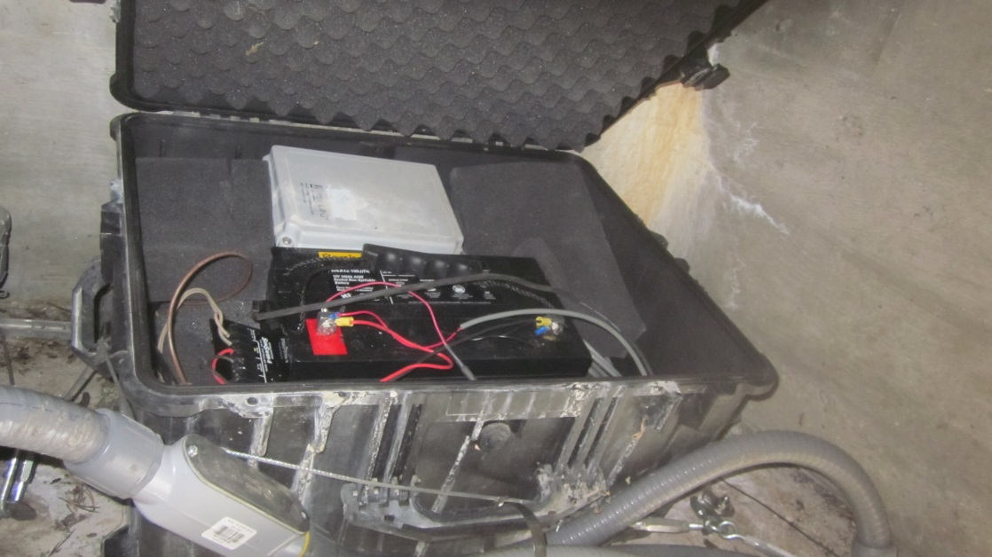
Datalogger enclosure
CR1000 Datalogger SN: 470
CS450-L PT 50ft cable-length SN:70010963
CS450-L PT 50ft cable-length SN:70010969
DTS-12 Turbidity Sensor ? cable-length SN: ?
CH100 12V Charge Regulator SN: 6667
Serial (RS232) -> USB converter->35ft USB to
bridge-top railing conduit
Install : 10/10/2012
Pelican Case(1620 case) installed 2002?
Waterlog Series H-424-MS Wireless SDI-12 RF Tranceiver (radio)
Werker 12V 100Ah AGM Sealed-No-Spill Battery
Sunsaver 6 12V, 10A, Solar Controller SS-6-12V
Photos: 7/30/2015

Slide 8
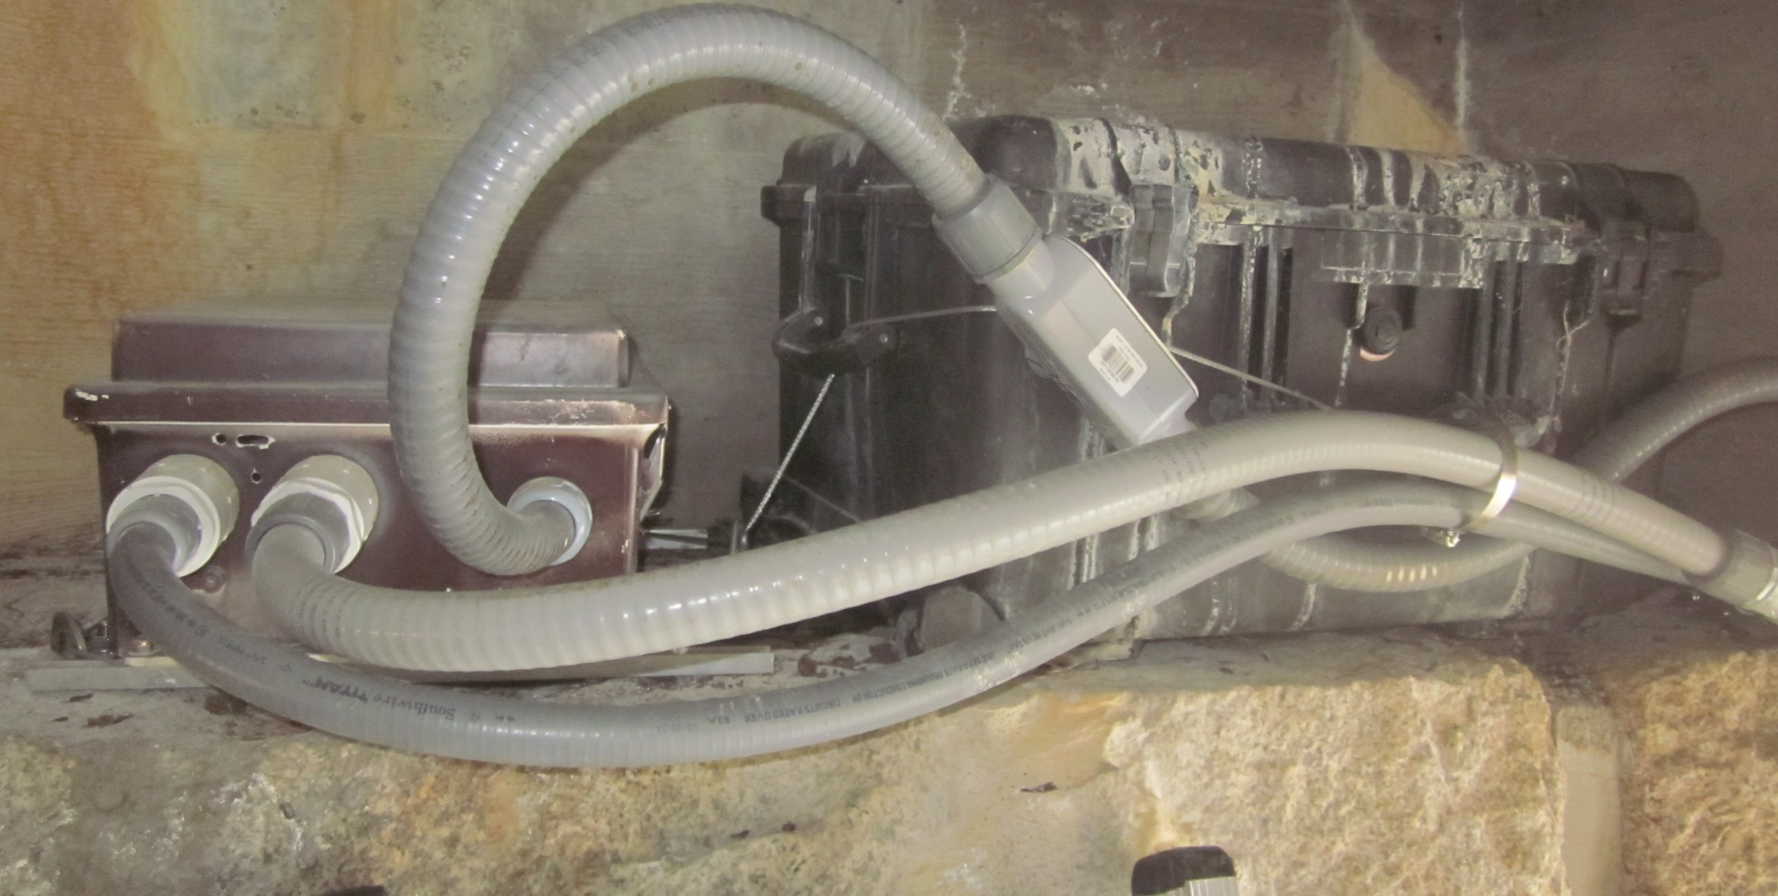
Datalogger enclosure
CR1000 Datalogger SN: 470
CS450-L PT 50ft cable-length SN:70010963
CS450-L PT 50ft cable-length SN:70010969
DTS-12 Turbidity Sensor ? cable-length SN: ?
CH100 12V Charge Regulator SN: 6667
Install : 10/10/2012
Pelican Case(1620 case) installed 2002?
Waterlog Series H-424-MS Wireless SDI-12 RF Tranceiver (radio)
Werker 12V 100Ah AGM Sealed-No-Spill Battery
Sunsaver 6 12V, 10A, Solar Controller SS-6-12V
Photo: 7/30/2015

Slide 9
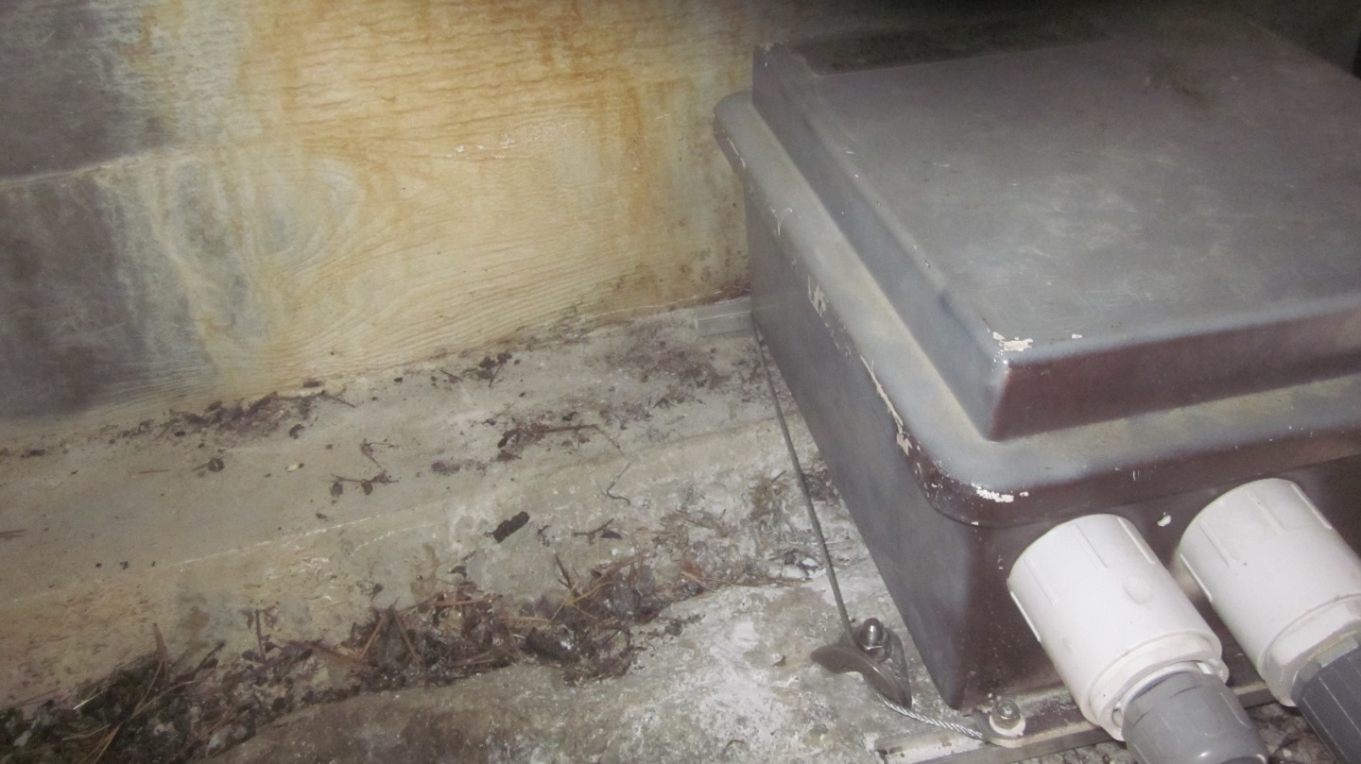
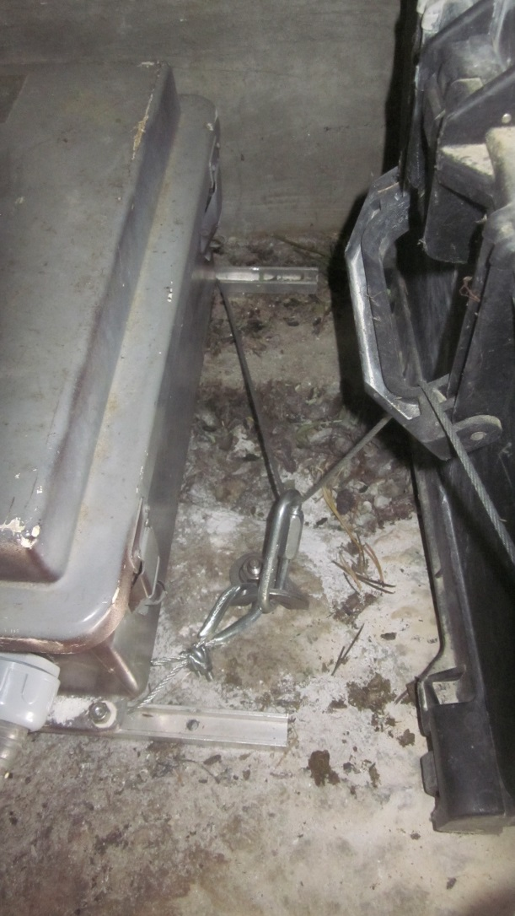
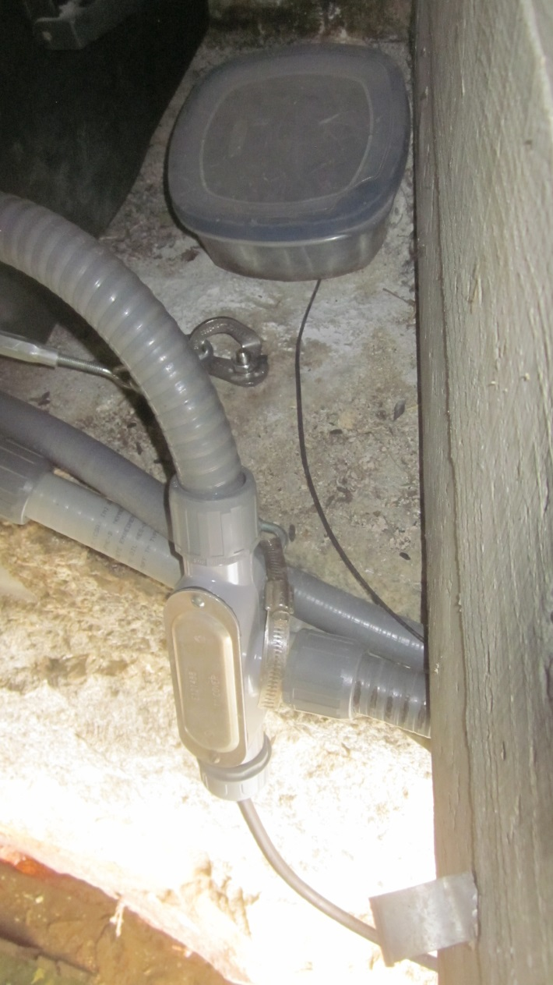
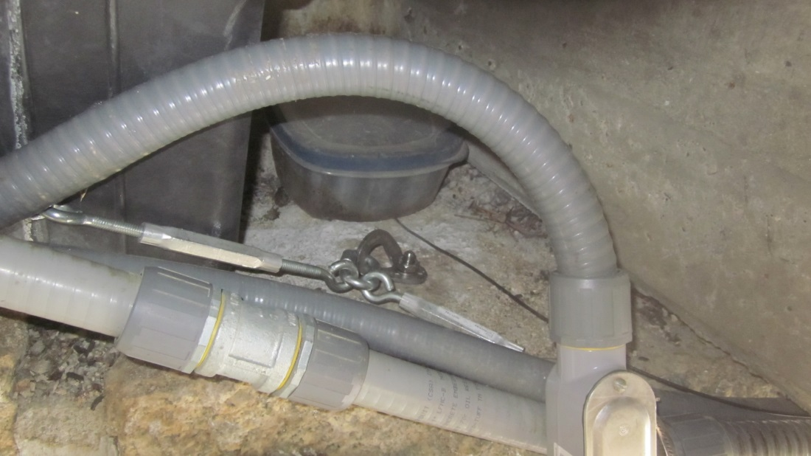
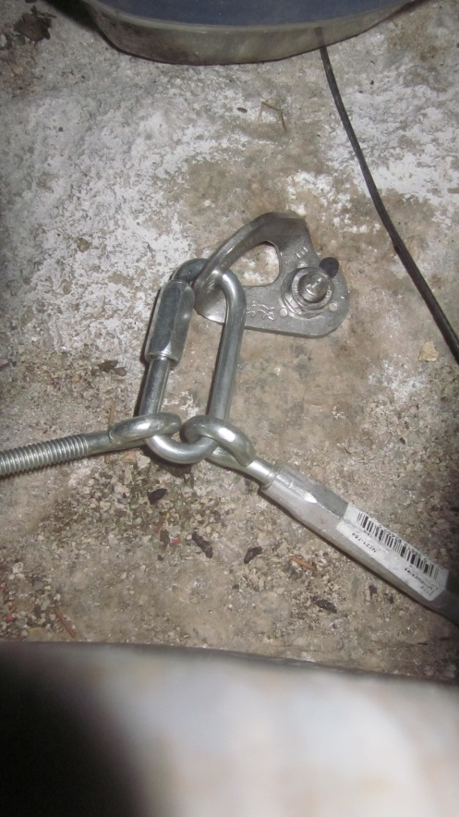
3 x 3/8 in. SS wedge bolts w/SS hangers
1/8 in. zinc-coated steel cable
2 zinc-coated turnbuckles
1 SS hose clamp (around conduit)
Solinst
cable
Anchor system: Installed 7/29/2015

Slide 10
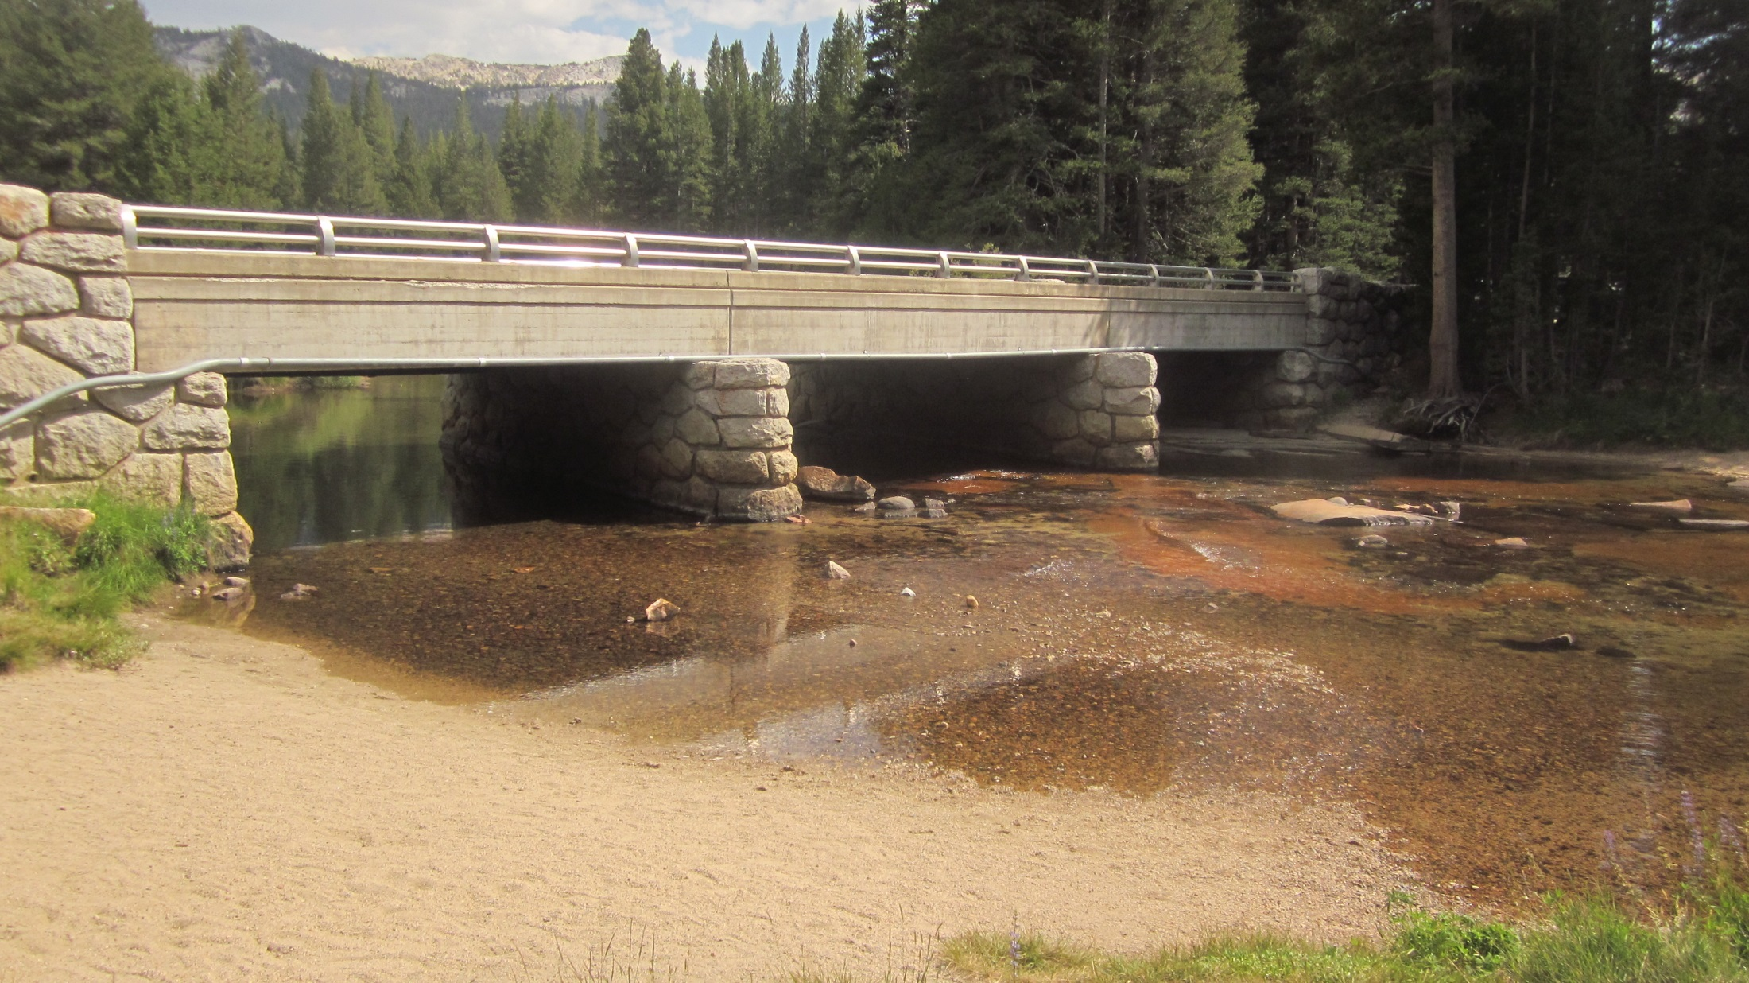
GH zero flow on 7/29/2015 @16:00:
2.79ft – 0.86ft = 1.93ft.
Section control: Gravel bar/slick rock
Photo: 7/29/2015

Slide 11
Maintenance Needs : Updated 8/2/2015
Type N COAX converter -> type N Yagi directional antennae.
Silicon old holes in datalogger enclosure
DTS-12 Turbidity sensor swap (scheduled Aug. 2015).
Tighten Staff Plate steel channel bolts.
Level survey.

